Slide 1

CAP444 OBJECT ORIENTED PROGRAMMING USING C++

Slide 2
Multiple Inheritance
class Derived: public Base1, public Base2, ......
class Base1:
class Base2:
.
.
.
class BaseN:
A
B
C

Slide 3



Multiple inheritance
Multiple Inheritance is a feature of C++ where a class can inherit from more than one class. i.e one subclass is inherited from more than one base class.
student

Slide 4
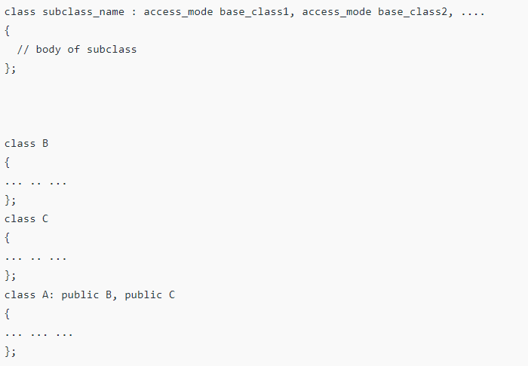
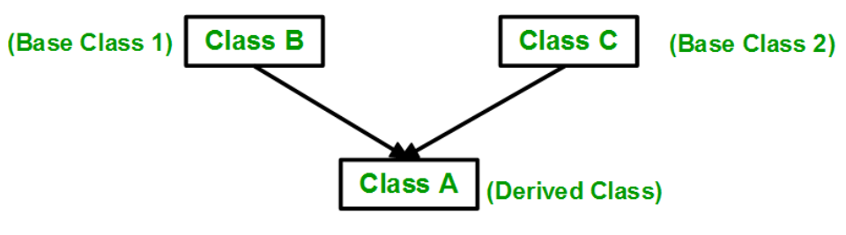
Multiple inheritance

Slide 5
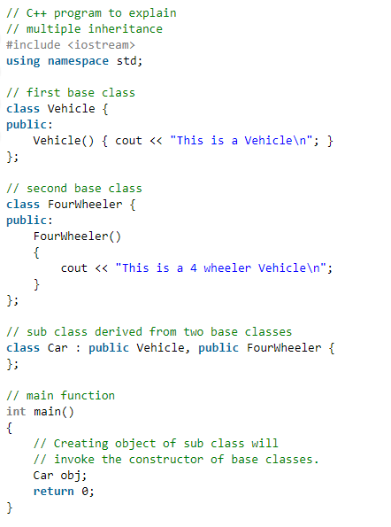
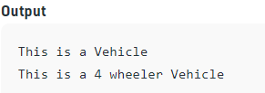

Slide 6
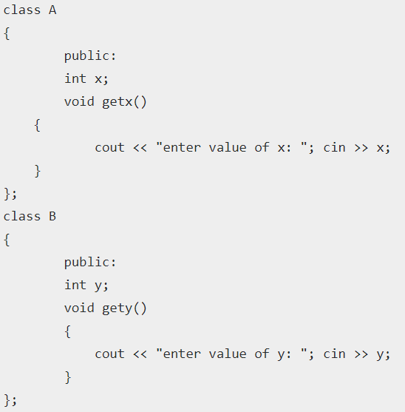
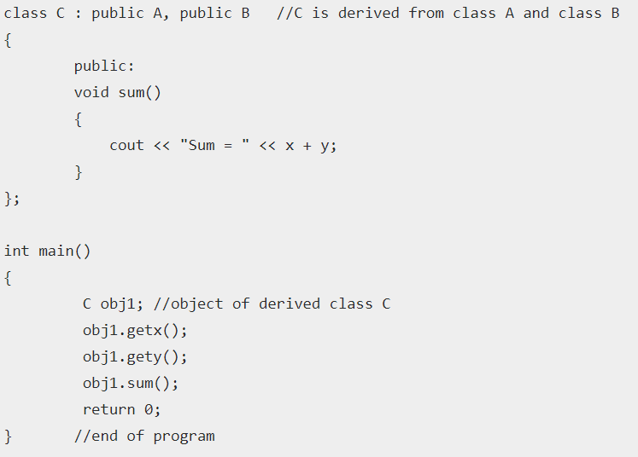


Slide 7
Ambiguity in Inheritance
In multiple inheritances, when one class is derived from two or more base classes then there may be a possibility that the base classes have functions with the same name.
getUniversityDetails()
getUniversityDetails()
?

Slide 8

We can solve using scope resolution operator
Syntax:
ObjectName.ClassName::FunctionName();

Slide 9
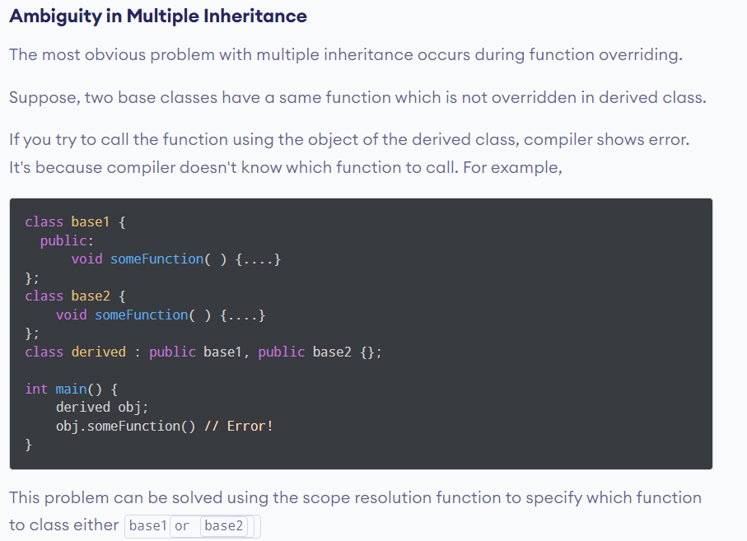
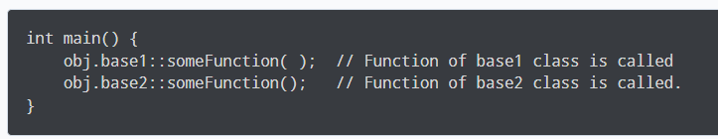

Slide 10
Multilevel inheritance:
One class is going to become base class for other derived class
PMFund
FundAmount=1000
Base Class for class Bank
Bank
BankName=“SBI” IFSCCode=“SBI001”
Derived Class from PMFund and
Base Class for Customer
Customer
Cust_Name, Cust_Id, BalanceAmount
checkBalance():
Derived Class from Bank

Slide 11
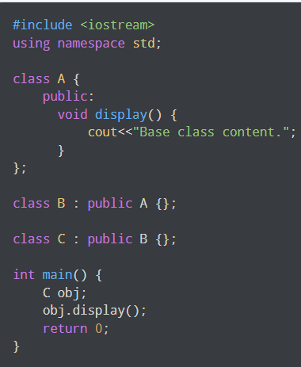
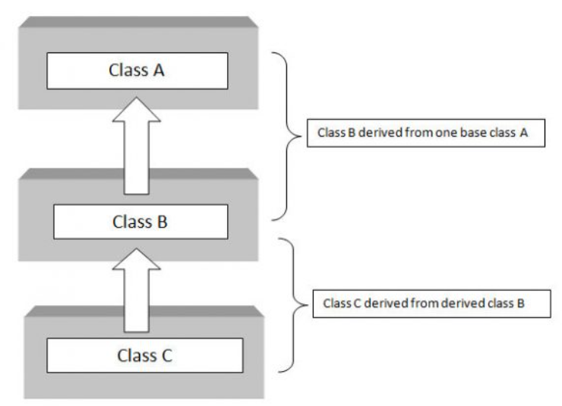

Slide 12
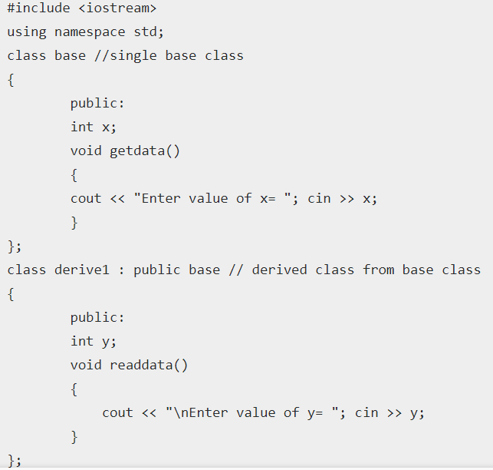
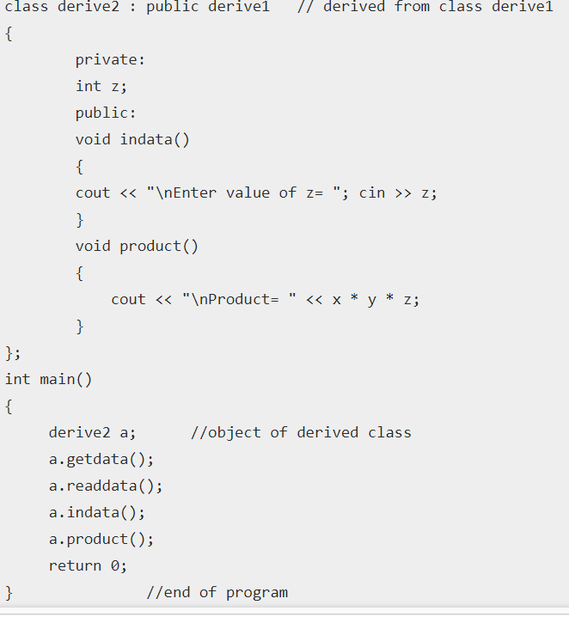
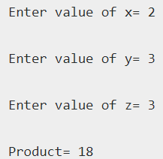

Slide 13
